Slide 1
Intelligent Fencing system
Final AML Presenation
Ruochen Fan , Gaoqi Dong , Ziqi Zhang
21 /03/2025

Slide 2
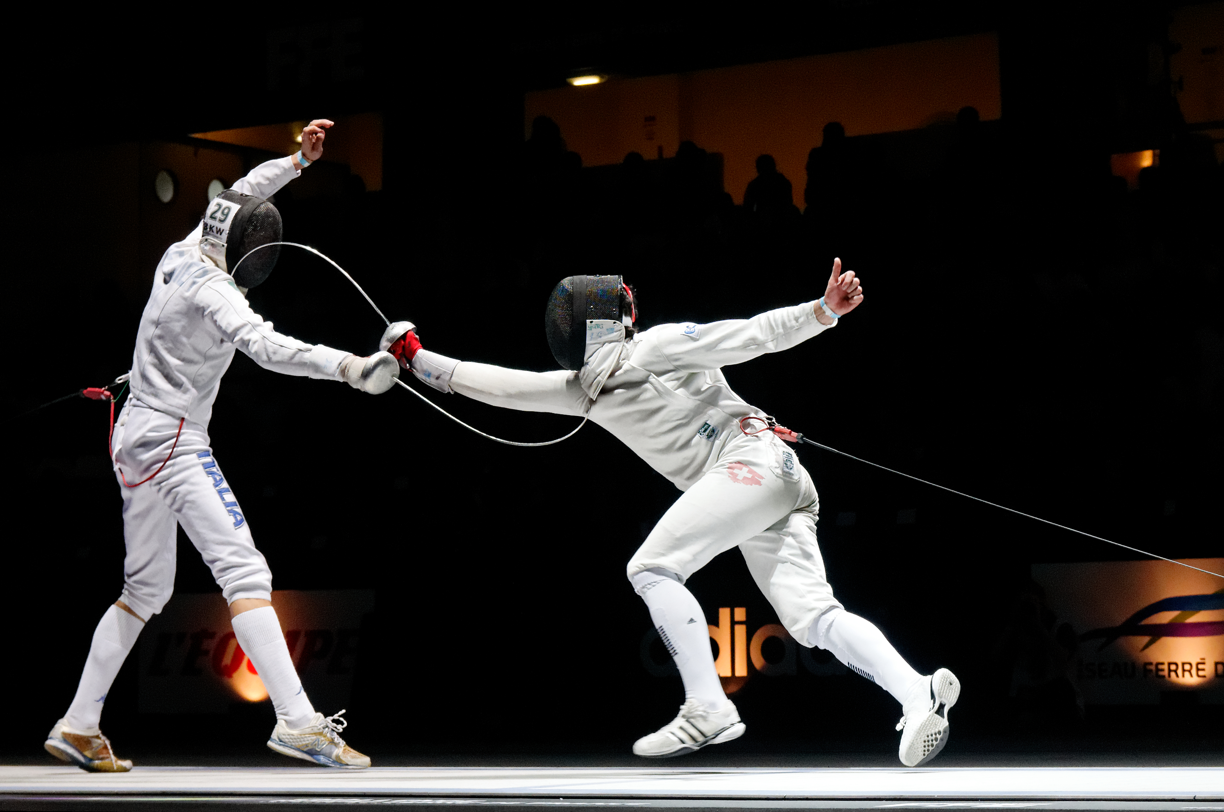
Problem Statement
A player scores a point when they hit their opponent without being hit.
How to judge if they hit each other simultaneously ----The player who has the right of way scores!
Problem: How to determine who has the right of way at each moment?
Notes:
In the fencing competition, a player hit opponent to get score. However, when they hit each other at same time, it is difficult to determine which player scores. It depends on which player on the right of way. So our problem is how to determine who has the right of way.

Slide 3
Background and Purpose
Importance of right of way
Motivation of our Intelligent system
Right of Way (RoW) is a fundamental rule in fencing, determining which fencer is awarded the point when both land a hit simultaneously. It is crucial in foil and sabre, influencing strategy, decision-making, and scoring.
Non-Markovian process– Decisions of Right of Way (RoW) depends on previous actions, making human judgment difficult.
Speed & subjectivity – It can be hard to distinguish subtle differences in movement. Fast exchanges make it hard for referees to judge consistently.
Notes:
右THE ATTACK MOTION FROM PLAYER IS VERY FASK, HUMAN EYES ARE HARD TO CAPTURE.

Slide 4
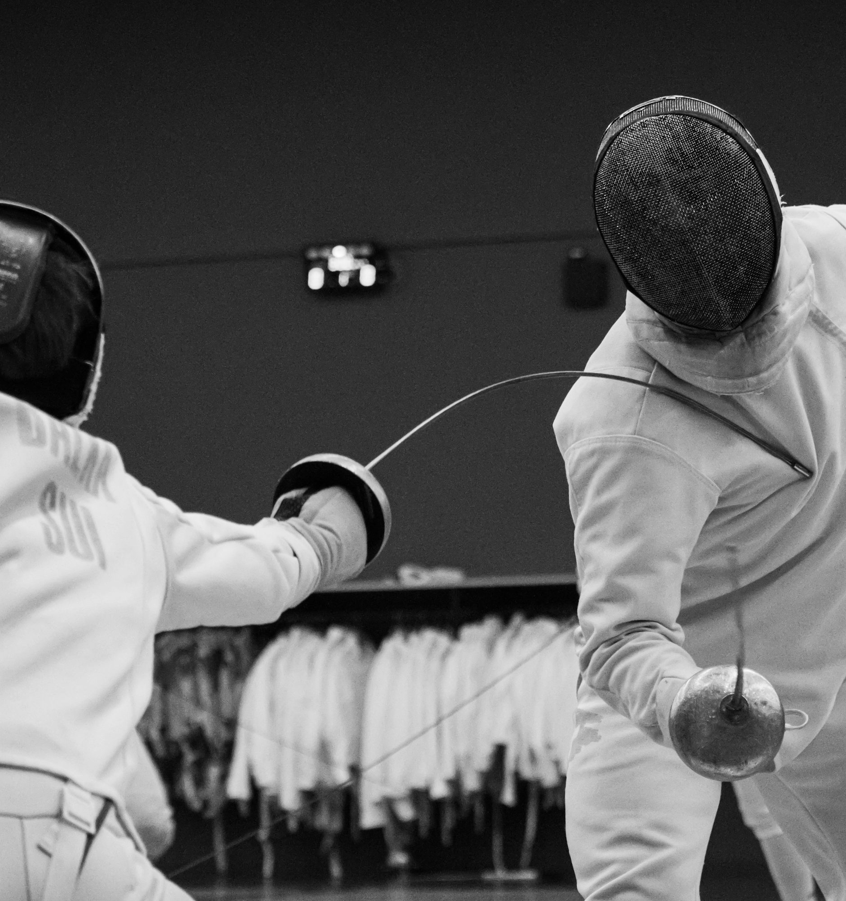
Summary of our work
Our team developed a robust and intelligent fencing system for right-of-way judgment.
We built a data-driven, wireless and real time posture estimation neural network that can classify a player's motion in real time with 93.4% accuracy.
A state machine serves as the backend to determine right of way based on player movements.
Notes:
It consists into 2 part

Slide 5
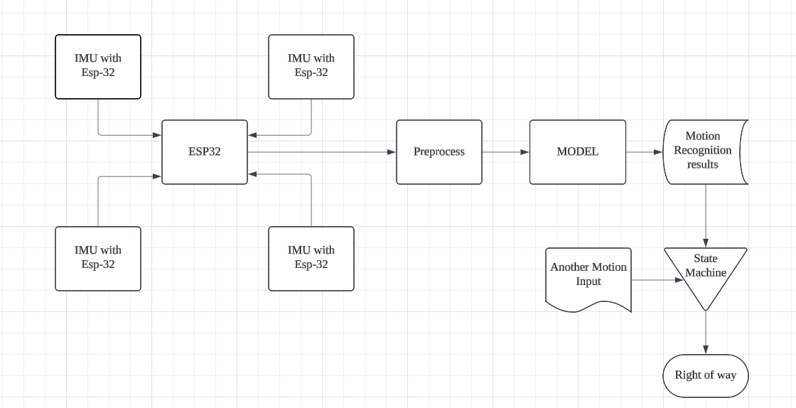
Overview of the system
Software and Hardware.

Slide 6
Methods

Slide 7
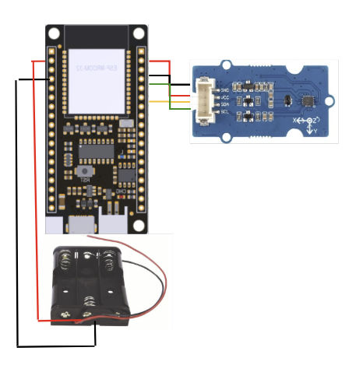


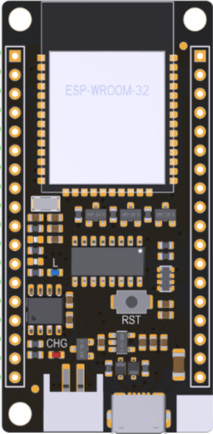
Overview of hard ware design
Light dimension microcontroller : ESP-32 DFRobot FireBeetle V2 Series
Wireless system : ESP-NOW based on WIFI
Safety power supply : AA battery with battery box
Input voltage 3.3V-5.5V
Motion capture: IMU sensors lcm20600
9 Degrees of Freedom (Inertial measurement unit) which combines gyroscope, accelerometer and electronic compass.
Notes:
Our system is built around the ESP-32 microcontroller which Small size and high performance is Suitable for this project. For wireless communication, we utilize ESP-NOW, a WiFi-based protocol that offers low power consumption and low latency, ensuring real-time data transmission.
In terms of power supply, we use AA batteries with a battery box to ensure safe and stable operation. The input voltage range is 3.3V to 5.5V and our battery box provides 4.5V input voltage. The core of our system is the IMU sensor, which enables motion capture, allowing real-time detection of acceleration and angular velocity.

Slide 8
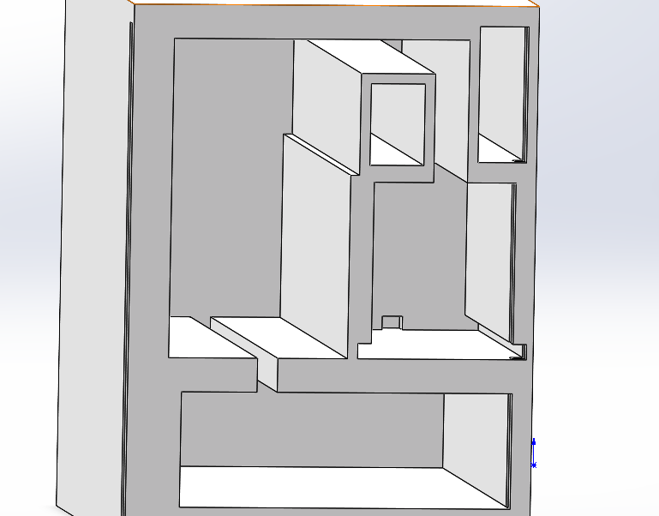
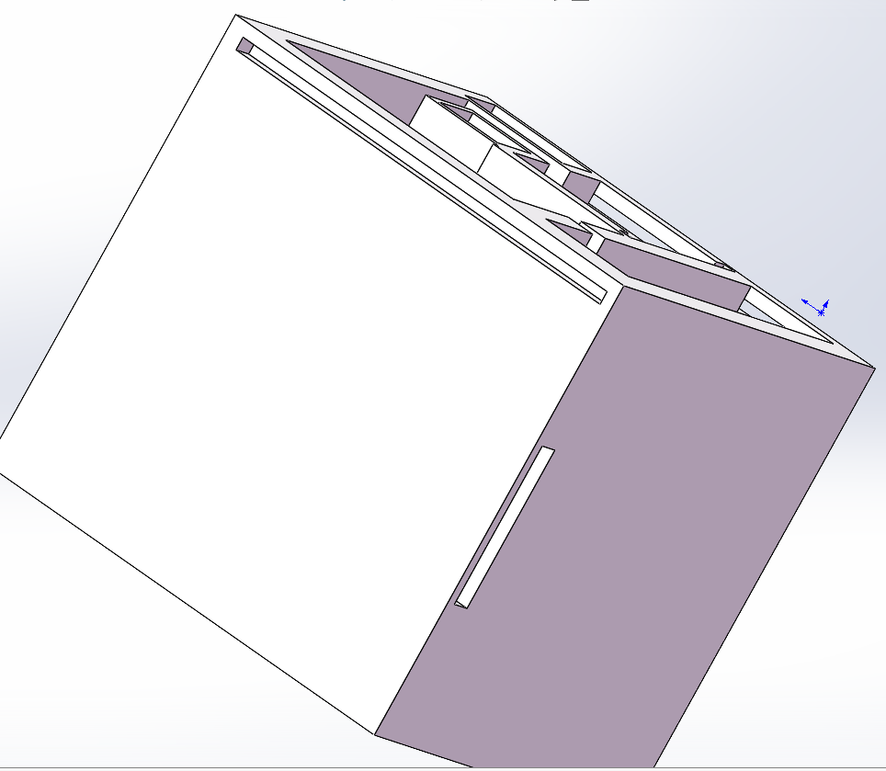
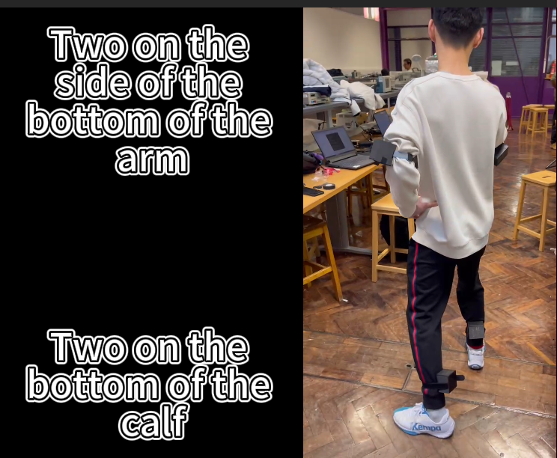
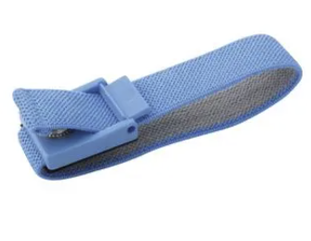
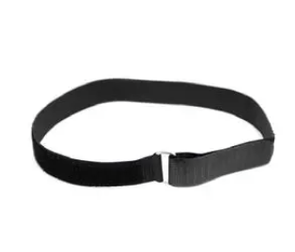
Overview of hard ware design
3D -printing
Boxes for fixing IMU sensors
Through hole for wrist strap
Notes:
To securely mount the IMU sensors, ESP-32 board and battery box, we have designed custom 3D-printed boxes. These enclosures ensure stability and accuracy in motion capture by keeping the sensors in a fixed position from the slots on the bottom.
Additionally, we have incorporated through holes in the design to accommodate wrist straps, allowing for easy and comfortable attachment to the user. This ensures that the sensors remain securely in place during movement, improving data reliability.

Slide 9
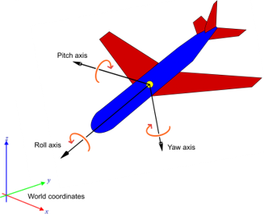
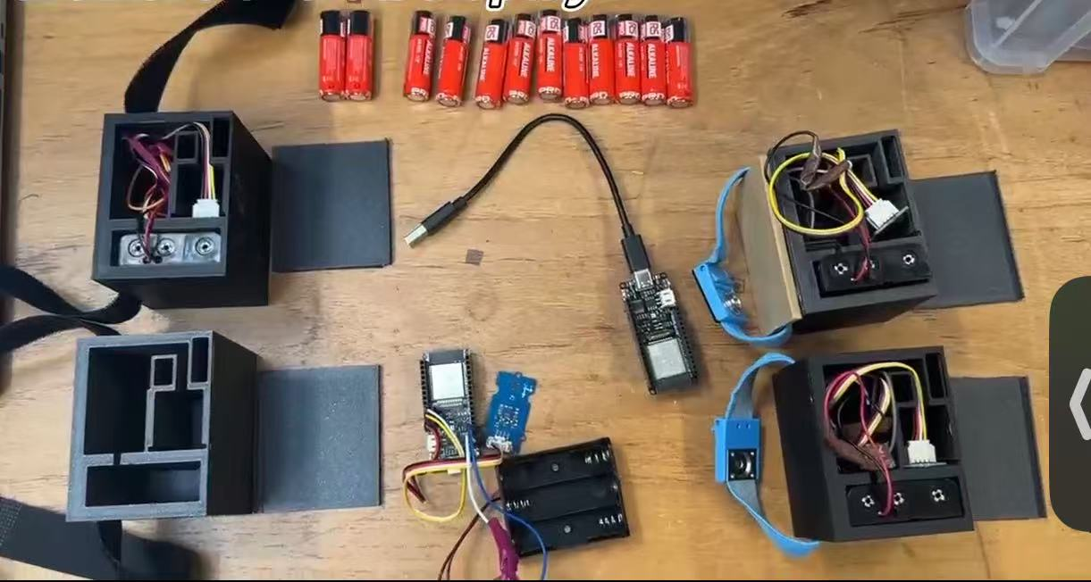
Overview of hard ware design
Communications
Calculate linear accleration
Developed a system with four transmitters and one receiver using ESP-NOW.
Approximate synchronization via Network Time Protocol (NTP).
An acknowledgment (ACK) mechanism is used.
Utilized a circular buffer at the receiver
Notes:
linear acceleration is calculated.

Slide 10
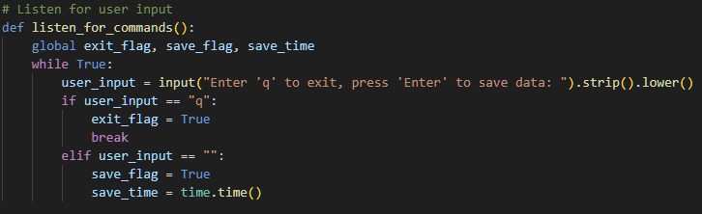
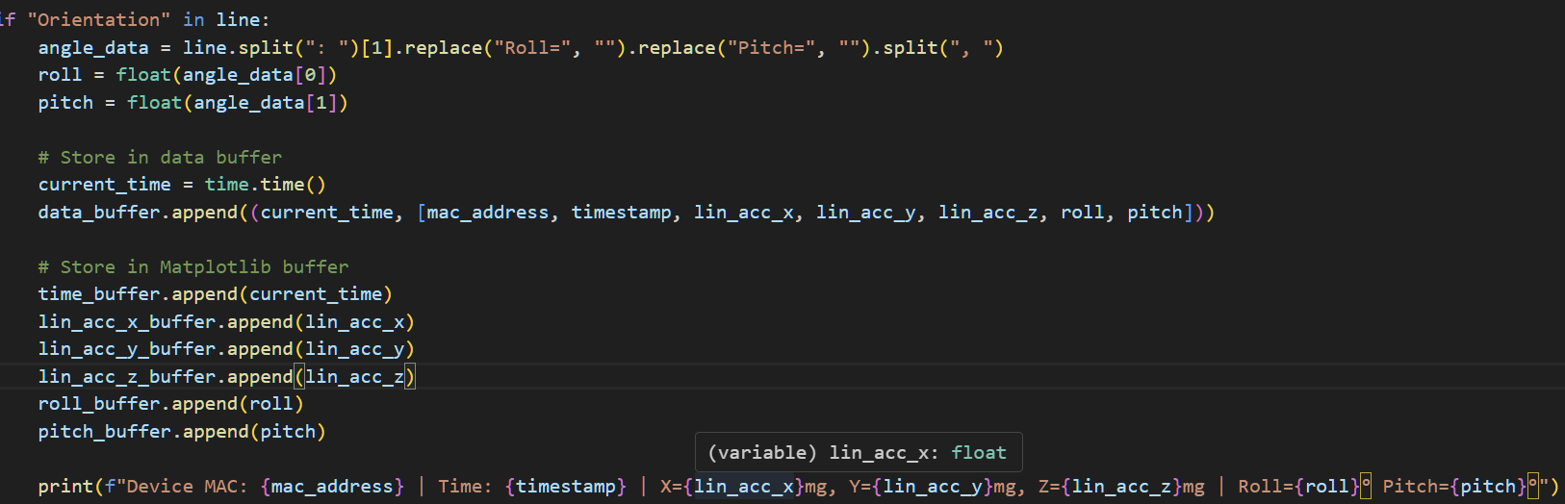
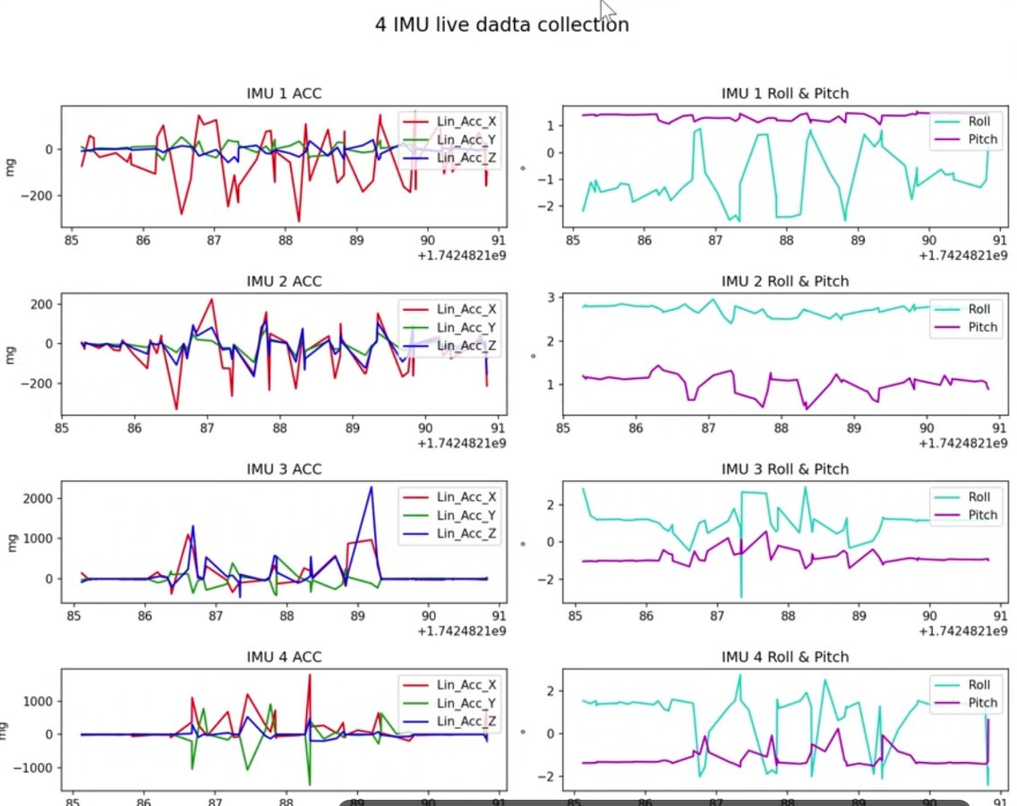
Data collection
4 Classes:
forward; backward; stop; attack
Data sample shape:
[20, 4, 5]
20 seq length, 4 IMU, 5 values
Acc_x, Acc_y, Acc_z, roll, pitch
Number of samples:
100 per class
33 per team member
Normalize IMU's data respectively
Sampling frequency 10Hz
When we press the key 2s window data in buffer will recorded in CSV file
Notes:
We classify movements into four categories: forward, backward, stop, and attack. Each data sample follows the shape [20, 4, 5], representing 20 sequence length, 4 IMUs, and 5 values per IMU.
For dataset size, we collected 100 samples per class, with each team member contributing approximately 33 samples. To ensure consistency, we normalize IMU data separately based on their labels. Additionally, we apply data augmentation by randomly masking certain moments to enhance model robustness.

Slide 11
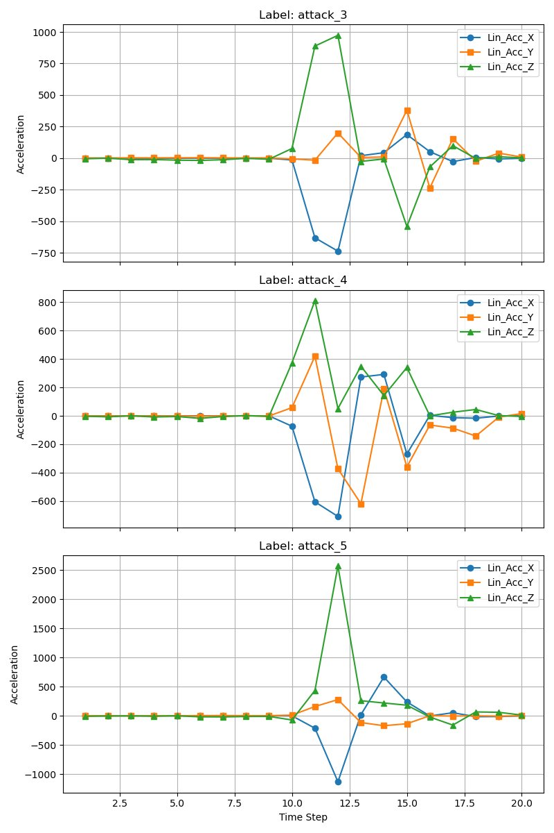
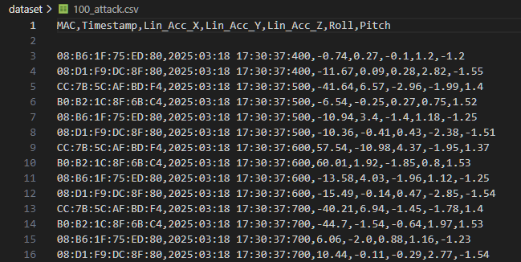
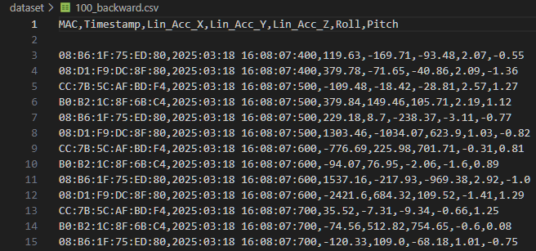
Data collection & Augmentaion
Augmentation: randomly mask several moments
400 original data samples expanded to 2000 samples by Augmentation.
Notes:
As for data augmentation, we used random mask method, which randomly set the data to zero for several moments of a 20 steps data sample. Eventually, the dataset size could be expanded to 2000.

Slide 12
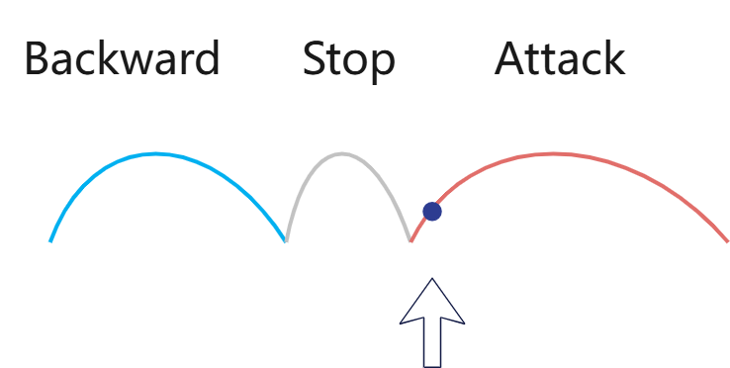
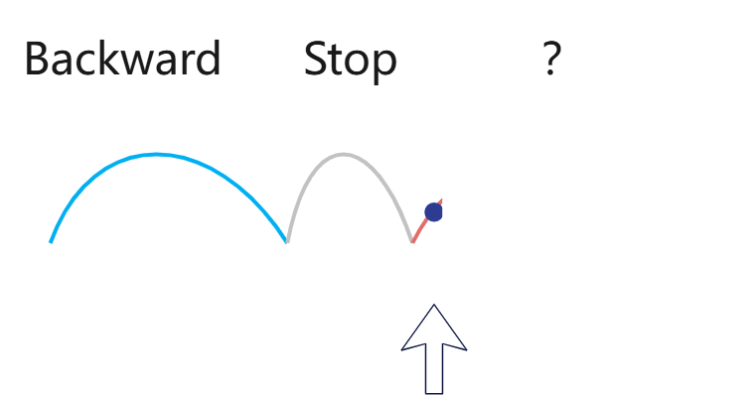


Labelling
Task of defining how to use the data.
How to precisely classify the motion of all the moments? (especially the margin of each action)
Use 1s past and future information for inference! (not casual inference)
Notes:
Labelling is to define the task of how the model use the data and what is the training object. In our case, we want to precisely classify the motion of all the moments so that we can use a state machine to allocate the RoW for each moment. The major difficulty is to classify the moments of the margin of each action, which is important in defining when an action begins and ends. It could be hard to classify the action only based on the very beginning of each action. (e.g. the first few moments of attack and forward are basically same). Thus our method is use 1 second past and future information for inference. The task is classify temporal action based on history and future information. Thus we should Allocate RoW offline. Online judge is also supported, but it it will include 1 second latency due to the design.

Slide 13
Model
To capture spatial pattern: Graph Attention Networks (GAT)
To capture bi-directional temporal pattern: Bi-Long-Short Term Memory (Bi-LSTM)
Stacked GAT and Bi-LSTM for 2 layers

Slide 14
State Machine
Player A, B
If any player stop/backward for 0.3s, it lose RoW.
If no one has RoW, RoW assigns to the one who forward/attack faster.
If A has RoW and is moving forward/attack, A keeps RoW.
If A end attack with RoW, transfer it to B immediately.

Slide 15
Results

Slide 16
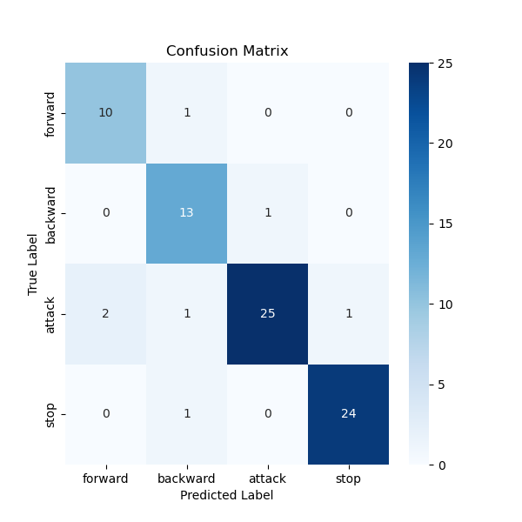
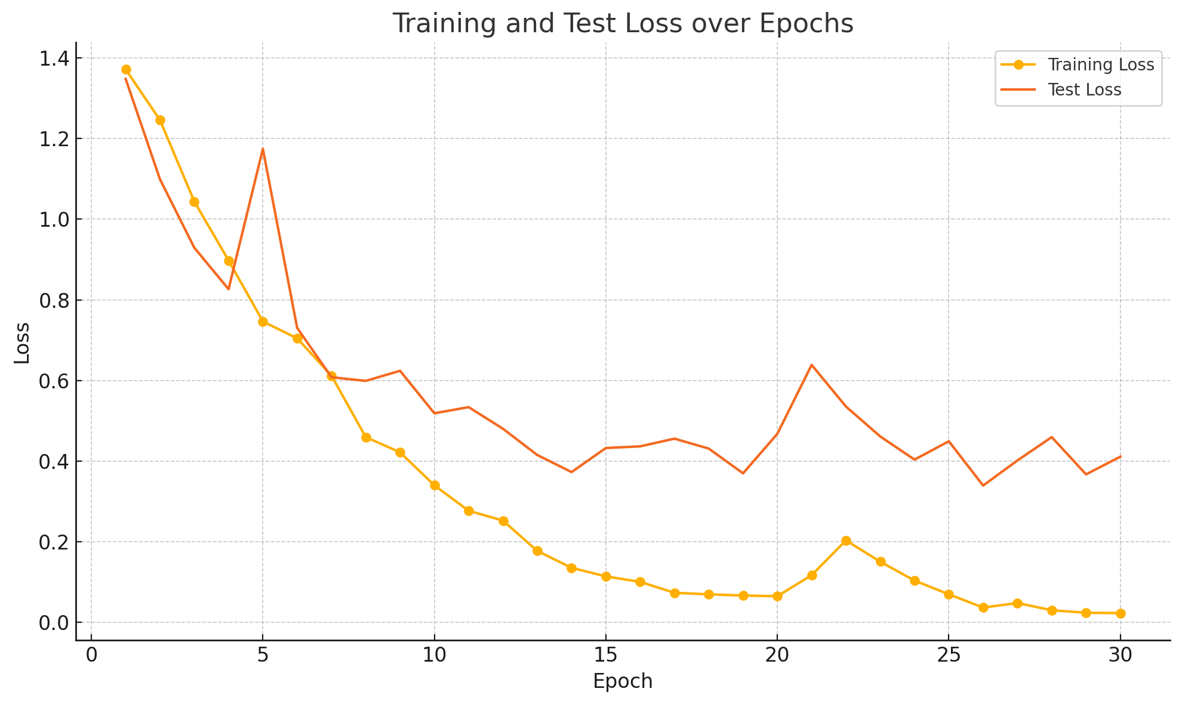
Model Performance​
Model: GAT+Bi-LSTM (2 layers) followed by a MLP classification layer.
Test Accuracy: 93.4%
Inference Speed: <10ms / sample
Notes:
The test accuracy reached nighty three point four percent, and for inference, each sample requires less than ten mili second.

Slide 17
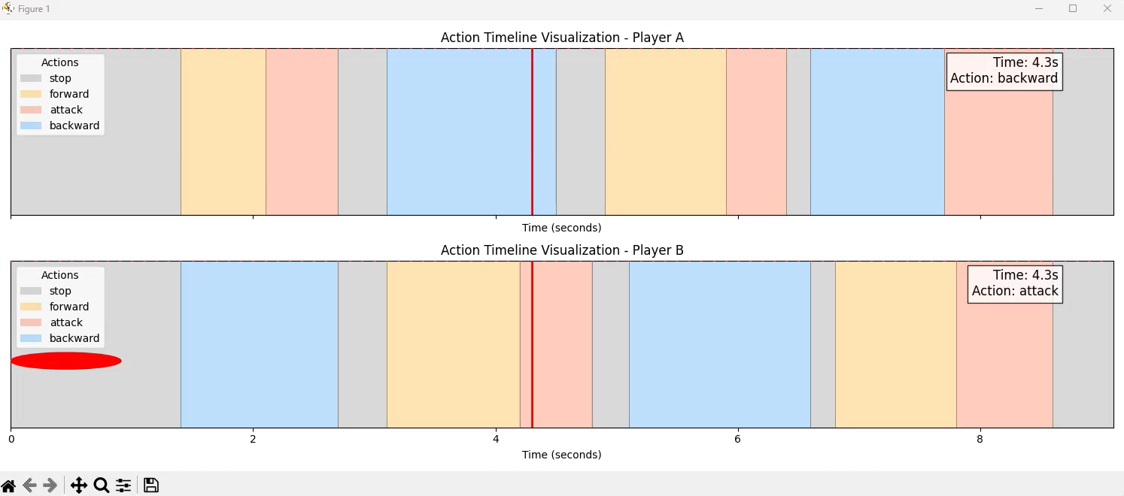
Offline mode
Movement classification and RoW assign
Notes:
Classify action of each moment. Assign RoW dynamically from start to end by using state machine. Determine which player scores according to RoW. In this video, red box is for attack, oringe is forward. Blue is backward and grey for stop. The Red point on the left represents the RoW.
​ In

Slide 18
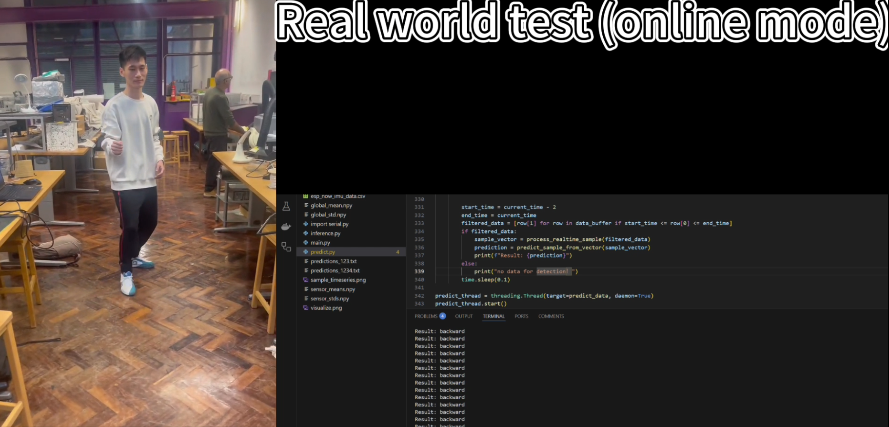
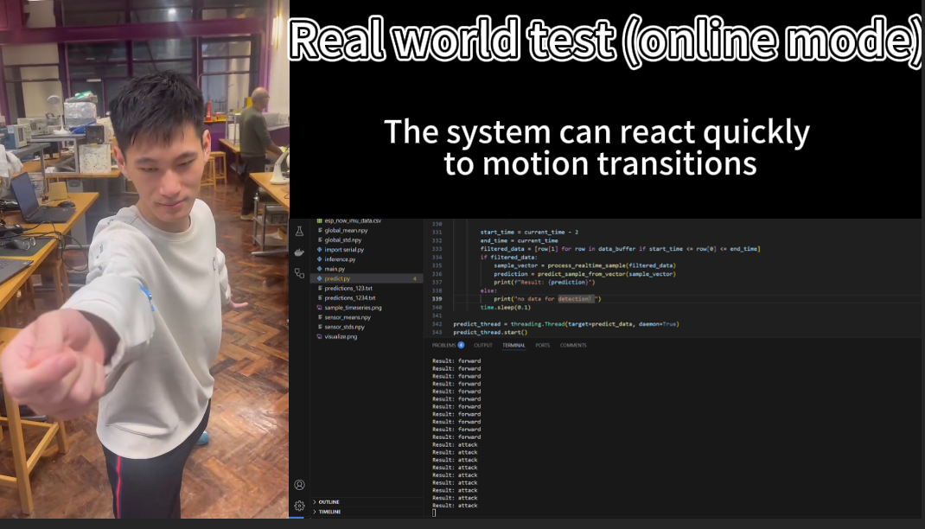
Online mode
Live movement classification
Normalize input data before predict the movement
1 second latency as a result of using future data to predict.
Testing on people did not participate for data collection still work
Notes:
In this mode, we first normalize the incoming IMU data using factors from training process before making movement predictions. This step ensures data consistency and improves prediction accuracy.
However, due to the need to use future data for predictions, a small latency is introduced. while, the delay is minimal, allowing for near real-time classification.
On the right, we can see a real-world test of the online mode, where the system processes motion data in real time and predicts the movement accurately. This implementation ensures smooth and reliable performance for fencing.

Slide 19
Video

Slide 20
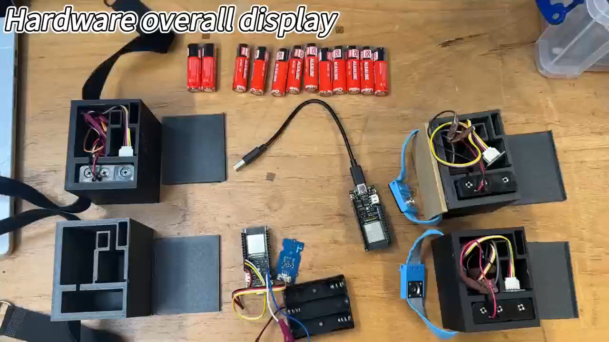
Video Demonstration

Slide 21
Thank you for listening !

